Slide 1
Anomaly Detection in Manufacturing
VLBAII – System Architectures

Slide 2
Business Problem & Objectives
Business Problem:
Rise in machine breakdowns of a PCB
manufacturing company which causes downtime
and leads to high added costs.
Business Objectives
Improve production efficiency
Reduce unplanned downtime
Detect breakdowns early
Reduce maintenance and repair cost
Provide clear insights into key factors causing machine wear.

Slide 3

Project Team Composition
Strategy & Project Management: Project management aspects | Sourya Shome Waseem Ahsraf Khan Rohith Nukala
Data Management & Analysis: data collection, exploration, and preparation | Sourya Shome Waseem Ashraf Khan Anjali Kalwar
Analytical Modeling: building and evaluating (ML) models | Sourya Shome Waseem Ashraf Khan Anjali Kalwar
Data Infrastructure & Operations: responsible for technological infrastructure for model deployment, maintenance, and scaling | Sourya Shome Anjali Kalwar Rohith Nukula
Project
coordination: Notion
Documentation space: OVGU cloud

Slide 4
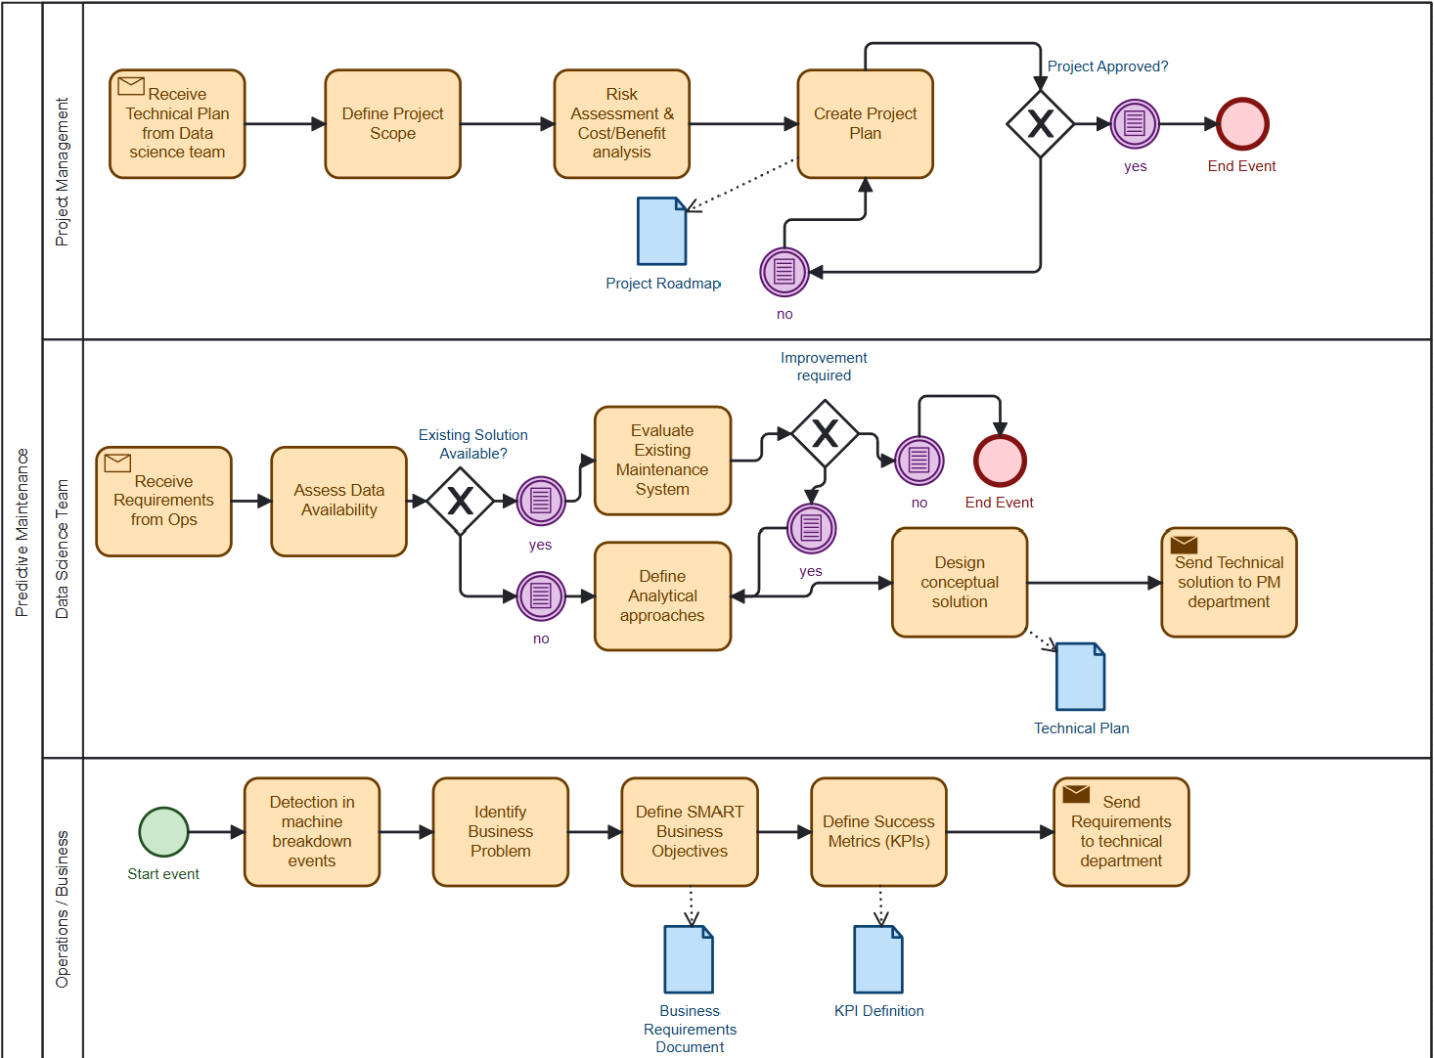
Conceptual Diagram
Conceptual diagram(BPMN)

Slide 5

Project Goal
Project goal:
Implement an ML-based anomaly detection system to predict machine failures leveraging MLOPS and support predictive maintenance.

Slide 6
Requirements
Functional Requirements:
Production data acquisition.
Detection of potential machine breakdowns.
Provision of actionable maintenance alerts.
Non Functional Requirements:
Explainability of prediction results.
Transparency and traceability of MLOps lifecycle.
Reproducibility and Continous monitoring of data drift.

Slide 7
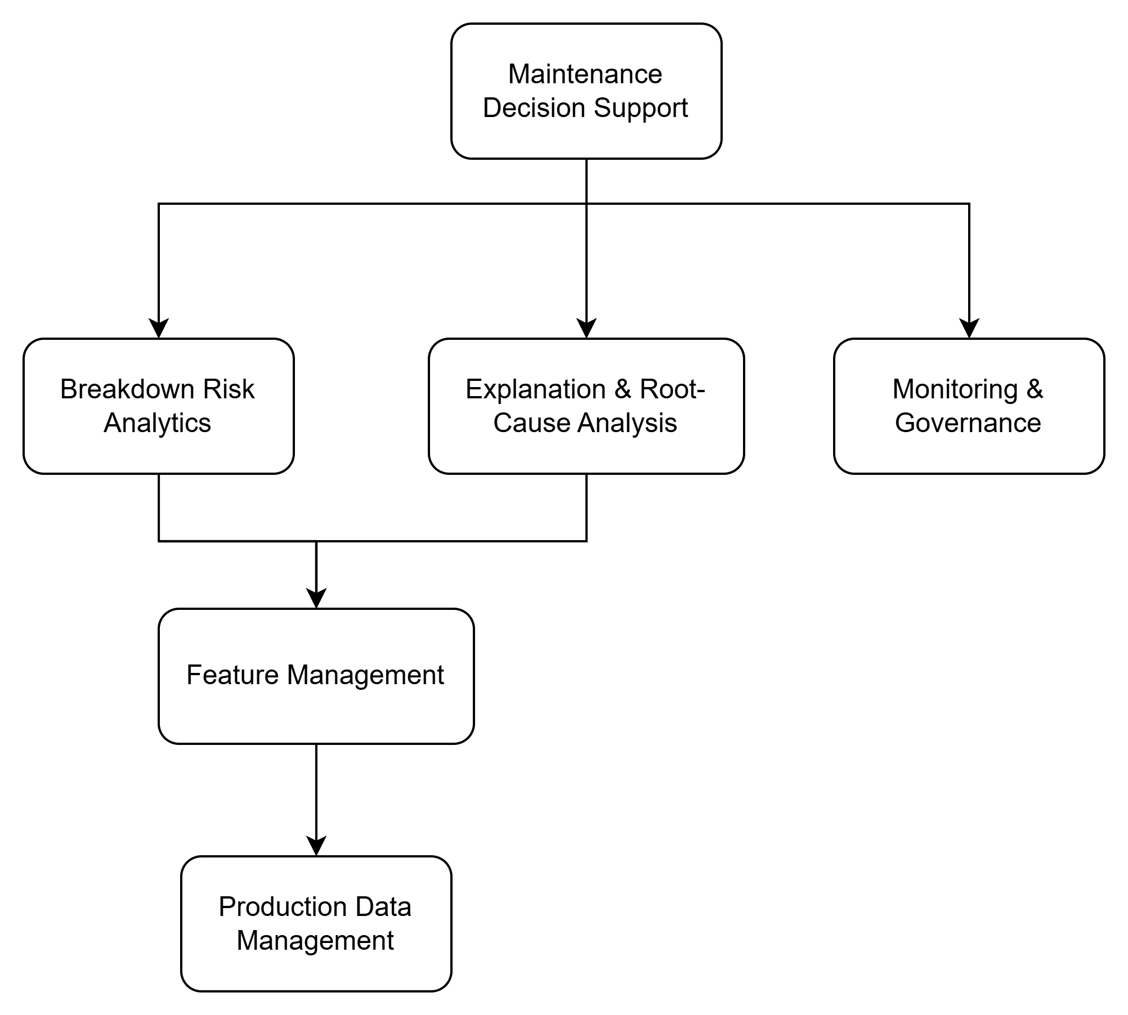
Business Architecture for Predictive Maintenance
Proposed solution: 1. End-to-end MLOps-based predictive maintenance pipeline from raw production data to maintenance alerts.
2. Using a layered architecture with data ingestion, feature engineering, model training, evaluation, inference, monitoring and dashboarding.
System Input:
Job-level schedule data including priority, family type, stage machine IDs, processing times, waiting time, tardiness, and BREAKS
System Output:
Breakdown risk score for jobs or machine-stage combinations.
Explainable alert with likely wear-driving factors.
Decision support for maintenance planning

Slide 8
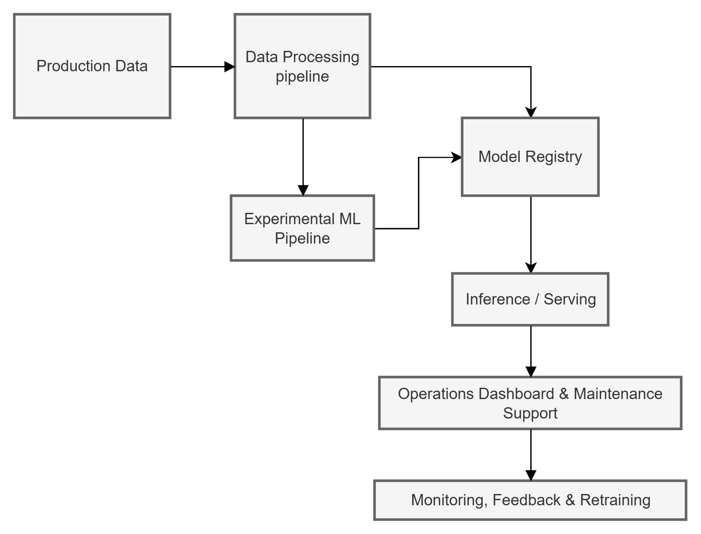
Technical Plan
Data integration layer – connect relevant production and machine data sources to the analytics workflow.
Data preparation pipeline – establish a reusable pipeline for validation, transformation, and provision of analysis-ready data.
Model development environment – develop and evaluate the anomaly detection model in an experimental setup.
Deployment architecture –prepare a serving component that delivers predictions to business users.
Monitoring and maintenance – monitor model and system performance and enable continuous improvement over time.
Workflow Diagram

Slide 9
Success Metrics
Provide early warnings and maintain consistent performance for effective maintenance decisions.
High recall to correctly detect breakdowns.
Ensure high precision to reduce false alarms and avoid unnecessary maintenance actions.
F1-score to balance false alarms, supporting overall reliable and cost-effective maintenance planning

Slide 10
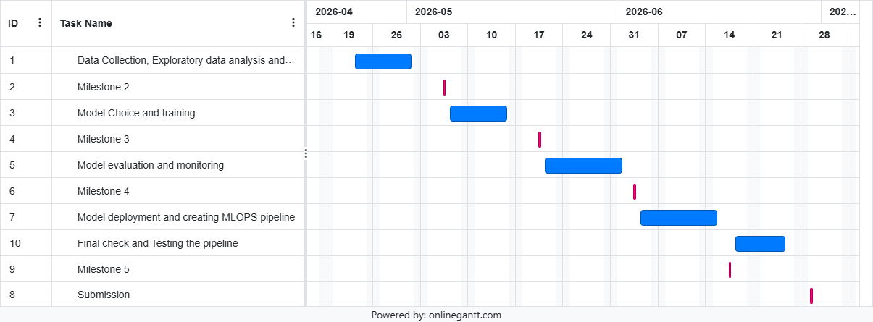
Gannt Chart

Slide 11
Thank you

